Slide 1
Chapter Four
Knowledge and Reasoning

Slide 2
Outline
KB agent and KB representation
General Idea about Logic
Kinds of logic
Propositional (Boolean) logic
PL connector priority
Types of sentences in Logic (Equivalence, validity, satisfiability)
Entailment
Inference rules and theorem proving Logical equivalence
Forms of logical expression
Example of PL Knowledge representation and inferencing (The Wumpus world)
Model of a world

Slide 3

Knowledge Base Agent
Knowledge base agent is an agent that perform action using the knowledge it has and reason about their action using its inference procedure.
Knowledge base is a set of representation of facts and their relationships called rules about the world.
Each fact/rules are called sentences which is represented using a language called knowledge representation language.
Declarative approach to building an agent (or other system):
Tell it what it needs to know (Knowledge base)
Ask what it knows
answers should follow from the KB

Slide 4
Most AI systems are made up of two basic parts
Knowledge base: facts about objects in the chosen domain
Inference mechanism(engine): a set of procedures that are used to examine the knowledge base in an orderly manner to answer questions, solve problems or make decisions within the domain

Slide 5
Knowledge Bases Agent
The agent must be able to:
Represent states of the world, actions, etc.
Incorporate new percepts (facts and rules)
Update internal representations of the world
Deduce hidden properties of the world
Deduce appropriate actions

Slide 6
Example of KB written in PROLOG
FACTS
female(azieb).
male(melaku).
female(selam).
parent(melaku,selam).
parent(azieb,selam).
RULE
father(X,Y):-male(X),parent(X,Y).
mother(X,Y):-female(X),parent(X,Y).
wife(X,Y):-parent(X,Z),parent(Y,Z).

Slide 7
Example
The above example consider a world of human beings and their relationships (gender, parent, etc). The complete representation of such information is state representation.
Agent should incorporate new percept like if necessary
father(Kebede, selam).
Mother(Tsehay, selam).
Male(kebede).
Agent should update internal representation of the world.
For example, if died(melaku) is given we should modify any fact that tells us about live history about melaku.
The agent should deduce hidden portion of the world like azieb and selam are beautiful.
Deduce appropriate action to query.
For example, for the query is aster beautiful? The agent will say yes or no.

Slide 8
Knowledge representation
Knowledge representation refers to the technique how to express the available facts and rules inside a computer so that agent will use it to perform well.
Knowledge representation consists of:
Syntax (grammar): possible physical configuration that constitute a sentence (fact or rule) inside the agent architecture.
For example one possible syntax rule may be every sentence must end with full stop.
Semantics (concept): determine the facts in the world to which the sentence refers
Without semantics a sentence is just a sequence of characters or binary sequences
Semantic defines the meaning of the sentence

Slide 9
Knowledge representation
E.g., In the language of arithmetic
x+2 ≥ y is a sentence;
x2+y > {} is not a sentence
x+2 ≥ y is true iff the number x+2 is not less than the number y
x+2 ≥ y is true in a world where x = 7, y = 1
x+2 ≥ y is false in a world where x = 0, y = 6
Given clear definition of semantics and syntax of a language, we call that language: logical language.
Knowledge representation is used to represent part of the world (facts and their association) into ideal computer system
KB for agent program can be represented using programming language designed for this purpose like LISP and PROLOG

Slide 10
What is Logic
Logic is concerned with reasoning and the validity of arguments.
In general, in logic, we are not concerned with the truth of statements, but rather with their validity.
That is to say, although the following argument is clearly logical, it is not something that we would consider to be true:
All lemons are blue
Eleni is a lemon
Therefore, Eleni is blue
This set of statements is considered to be valid because the conclusion (Eleni is blue) follows logically from the other two statements, which we often call the premises.

Slide 11
Logic
Logic in AI is the key idea for KB design, KB representation and inferencing (reasoning)
Logic is formal languages use for representing information so that conclusions can be drawn.
Logic is the study of the principles of reasoning and arguments towards the truth of a given conclusion given premises.
Logic is the systematic study of the general conditions of valid inferences
Logic includes…
Formal system of defining the world
Syntax
Semantics
A proof theory:
It is Rules for determining all entailments (given the hidden property of the world)
A set of rules for deducing the entailment of a set of sentences.

Slide 12
Kinds of Logic
In mathematics there are different kinds of logics. Some of these according to order of their generality are
Prepositional logic
First order logic
Second order logic and more
Prepositional logic and its application will be discussed in this now then we will discusse first order logic
First order logic can be used to design, represent or infer for any environment in the real world.

Slide 13
Prepositional (Boolean) logic (PL)
Preposition is statement which is either true or false but not both at any time.
A statement is a sentence which is either true or false.
PL uses declarative sentences only
PL doesn’t involve quantifiers.
Not all sentences are statement (interrogatives, imperatives and exclamatory)
Preposition can be conditional or unconditional
Examples
Socrates is mortal
If the winter is severe, students will not succeed.
All are the same iff their color is black
In prepositional logic, symbols represent the whole preposition.
Examples:
M = Socrates is mortal, W = winter is sever, S = students will not succeed

Slide 14
Prepositional (Boolean) logic (PL)
Preposition symbols can be combined using Boolean connectives to generate new preposition with complex meaning.
Symbols involved in PL:
Logical constants (TRUE and FALSE)
Preposition symbols (also called atomic symbols) like M, W, S
Logical connectives ¬ (negation), ∧ (conjunction), ∨(disjunction), ⇔ (bi-implication or equivalence), ⇒ (implication) and parenthesis
Rules
Logical constants and propositional symbols are sentence by them selves.
Wrapping parenthesis around a sentence yield a sentence like (P V Q)
Literal are atomic symbols or negated atomic symbols
Complex sentence can be formed by combining simpler sentences with logical connectors

Slide 15
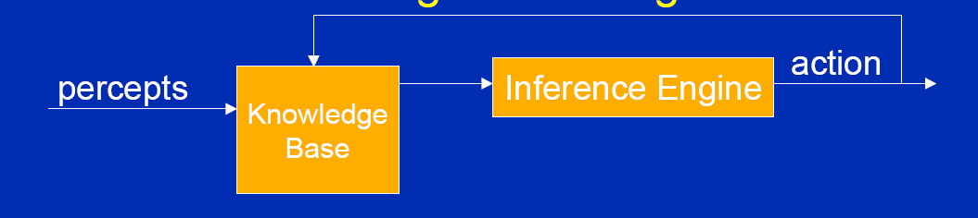
PL connector priority
Priority of logical connectives from highest to lowest
Parenthesis
Negation
Conjunction
Disjunction
Implication
Bi-implication
General principle of KB agent function

Slide 16
Types of sentence
Given a sentence α, this sentence according to the world considered can be
Valid (tautology)
Invalid (contradiction)
Satisfiable (neither valid nor invalid)
Unsatisfiable (equivalent to Invalid)

Slide 17
Validity (tautology)
A sentence is valid iff it is true under any interpretations in all possible world.
Proof methods: Truth -Tables and Inference Rules
Validity is connected to inference via the Deduction Theorem:
KB ╞ α if and only if (KB ⇒ α)
Example:
x>4 or x<=4;
Water boils at 100 degree centigrade
Human has two legs (may not be valid)
Books have page number (may not be valid)

Slide 18
Satisfiablility
A sentence is satisfiable iff there is some interpretation in some world for which it is true.
A set of sentences is satisfiable if there exists an interpretation in which every sentence is true (it has at least one model).
Proof Methods: Truth-Tables
Every valid sentence is satisfiable
Example: x+2 = 20
Every student of AI are in their class
A sentence which is not satisfiable is unsatisfiable (contradiction).

Slide 19
Entailment
Entailment means that one thing follows from another:
It can be represented by ╞ symbol (double turnstyle)
KB ╞ α shows α can be entailed from KB
Knowledge base KB entails sentence α if and only if α is true in all worlds where KB is true.
E.g., the KB containing “the Giants won” and “the Reds won” entails “Either the Giants won or the Reds won”
E.g., x+y = 4 entails 4 = x+y
E.g., x+y = 4 entails x= 2 and y = 2
Entailment is a relationship between sentences (i.e., syntax) that is based on semantics

Slide 20
Inference Procedure
An inference procedure is a procedure used as reasoning engine.
It can do:
Given KB, generate new sentence α that can be entailed by KB and we call the inference procedure entail α
Given KB and α, it will prove whether α is entailed by KB or not
KB ├_{i} α means sentence α can be derived from KB by procedure i (|- is called turnstyle or single turnstyle)
The record of operation of a sound inference procedure is called a proof

Slide 21
Inference Procedure property
Soundness: inference procedure i is said to be sound: if whenever KB ├_{i} α, it is also true that KB╞ α
Completeness: inference procedure i is said to be complete if whenever KB╞ α, it is also true that KB ├_{i} α
Soundness of an inference can be established through truth table
for example and inference procedure that entails P from a KB which consists of P→Q & Q is not sound as shown bellow
 | P | Q | P→Q | Remark
1 | T | T | T | Q, P→Q, & P are true
2 | T | F | F | Premises doesn’t satisfied
3 | F | T | T | Premises satisfied but not the conclusion
4 | F | F | T | Premises doesn’t satisfied

Slide 22







Rules of inference for PL
Soundness of an inference can be established through truth table
Example (P V H) ∧ ¬ H) ⇒ P
To prove validity of a sentence, there are a set of already identified patterns called inference rules. These are:
Modes Ponens or implication elimination
And Elimination
And introduction
Or introduction
Double negation elimination
Unit resolution
Resolution

Slide 23
Following are some terminologies related to inference rules:
Implication: It is one of the logical connectives which can be represented as P → Q. It is a Boolean expression.
Converse: The converse of implication, which means the right-hand side proposition goes to the left-hand side and vice-versa. It can be written as Q → P.
Contrapositive: The negation of converse is termed as contrapositive, and it can be represented as ¬ Q → ¬ P.
Inverse: The negation of implication is called inverse. It can be represented as ¬ P → ¬ Q.

Slide 24
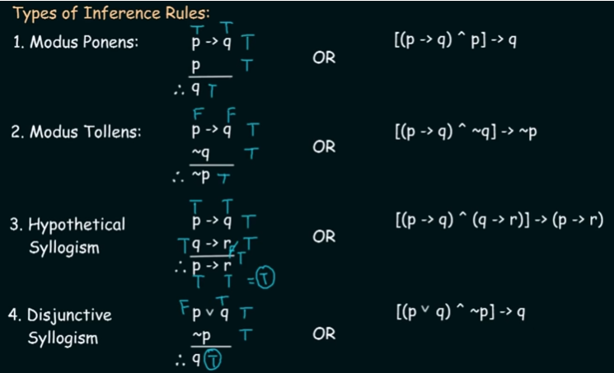
Rule of inference for propositional logic
Rules of Inerence:- are the templates for constructing valid argument
Inference: deriving conclusion from evidences

Slide 25
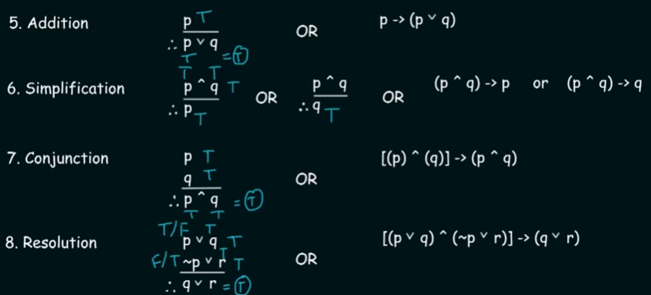

Slide 26
What rule is used for the conclusion?
If world population continues to grow, then cities will become hopelessly crowed; If cities become hopelessly overcrowded, then pollution will become intolerable. Therefore, if world population continues to grow then pollution will become intolerable.
Either Yohanes or Thomas was in Ethiopia; Yohanes was not in Ethiopia. Therefore, Thomas was in Ethiopia.
If twelve million children die yearly form starvation, then something is wrong with food distribution; Twelve million children die yearly form starvation. Therefore, something is wrong with food distribution.
If Japan cares about endangered species, then it has stopped killing whales; Japan has not stopped killing whales. Therefore, Japan does not care about endangered species.
If Napoleon was killed in a plane crash, then Napoleon is dead; Napoleon is dead. Therefore, Napoleon was killed in a plane crash.

Slide 27
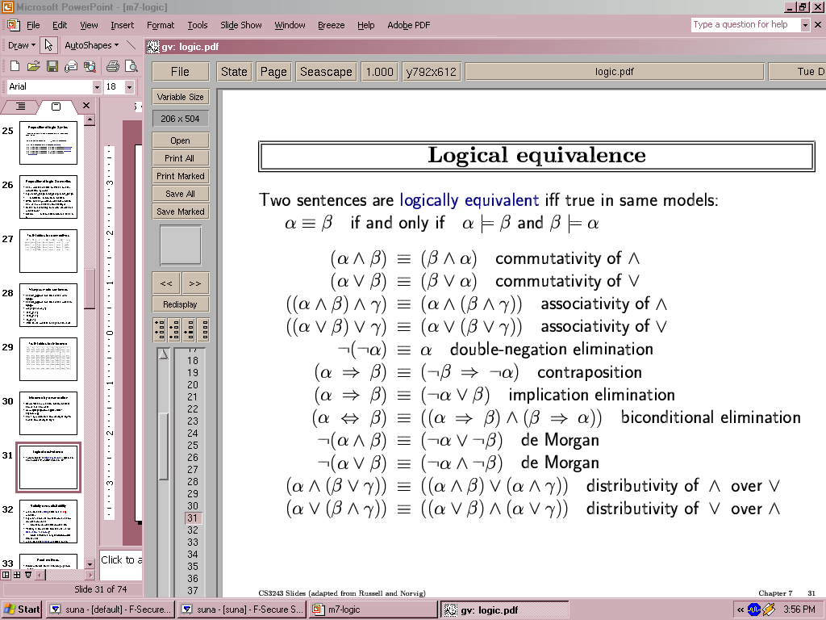
Logical equivalence
Two sentences are logically equivalent iff they have the same truth value in all possible world
equivalently α ≡ ß iff α╞ β and β╞ α

Slide 28
Prove that (P V H) ∧ ¬ H) ⇒ P is valid
Prove S, given that:
(P∧Q)
(P→R)
(Q∧R) →S

Slide 29
Forms of Logical expression
There are different standard forms of expressing PL statement. Some of these are:
Clausal normal form: it is a set of one or more literals connected with the disjunction operator (disjunction of literals). Example ~P ∨ Q ∨ ~R is a clausal form
Conjunctive normal forms (CNF): conjunction of disjunction of literals or conjunction of clauses. Example (A ∨ B) ∧ (C ∨D)
Disjunctive normal form (DNF): disjunction of conjunction of literals. Example (A ∧ B) ∨(C ∧ D)
Horn form: conjunction of literals implies a literal. Example (A ∧ B ∧ C ∧D)=>E
A BNF (Backnus-Naur Form) grammar of sentences in propositional logic.
Sentence → Atomic Sentence ⏐ Complex Sentence
AtomicSentence → True ⏐ False⏐ P ⏐ Q ⏐ R ⏐ …
ComplexSentence → (Sentence) ⏐Sentence Connective Sentence ⏐ ¬Sentence
Connective → ∧ ⏐ ∨ ⏐ ⇔ ⏐ ⇒

Slide 30
Inference procedure and normal forms
The inference procedure that we have seen before are all sound
If KB is represented in CNF, the generalized resolution inference procedure is complete
If KB is represented in Horn form, the generalized modes ponens algorithm is complete
It can be proved that every sentence of human language can be represented using logic as CNF. However, it is not possible in Horn form.
Therefore, CNF is a more powerful representation technique for knowledge
But, Horn form representation of knowledge is easily understandable and convenient. It also require polynomial time inference procedure.

Slide 31
Generalized Resolution for PL
Given any two clauses A and B, if there are any literal P₁ in A which has a complementary literal P₂ in B, delete P₁ and P₂ from A and B and construct a disjunction of the remaining clauses.
The clause constructed is called the resolvent of A and B.
For example, consider the following clauses
A: P ∨ Q ∨ R
B: ~P ∨ Q ∨ M
C: ~Q ∨ S
From clause A and B, if we remove P and ~P, it resolves into clause
D : Q ∨ R ∨ Q ∨M ≡ Q ∨ R ∨ M .
If Q of clause D and ~Q of clause C resolved, we get clause
E: R ∨ M ∨ S

Slide 32
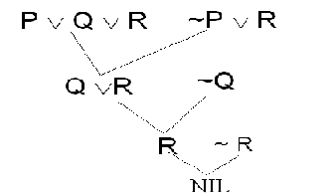
Generalized Resolution for PL
As another example, consider the following clauses
A: P ∨ Q ∨ R
B: ~P ∨ R
C: ~Q
D: ~ R
An empty clause, which is false. This proves the contradiction.
Note: in order to apply resolution for proving a theory, make sure first all the knowledge is in its clausal form

Slide 33
Example: Resolution
Prove that r follows from:
(p ∧ q) → (r ∨ s) -(1)
p → ~ s -(2)
p ∧ q -(3)
Solution:
Clause (1) in Clausal form
~ (p ∧ q) ∨ (r ∨ s)
≡ {~ p ∨ ~ q ∨ r ∨ s} - (1)
Clause (2) in Clausal form
{~ p ∨ ~ s} - (2)
Clause (3) in Clausal form
{p} - (3)
{q} - (4)
Assume not r which {~ r} in Clausal form - (5)

Slide 34
Example: Resolution
Using inference rules: from unit resolution rule of (1) and (5)
{~p ∨ ~ q ∨ s} - (6) (resolve r with ~r and get resolvent)
from unit resolution of (3) and (6)
{~ q ∨ s} - (7) (resolve p with ~p and get resolvent)
from (4) and (7)
{s} - (8) (resolve q with ~q and get resolvent)
from (2) and (8)
{~ p} - (9) (resolve p with ~p and get resolvent)
from (3) and (9)
{} - (10)
Therefore r follows from the original clauses

Slide 35
Converting to CNF
Converting the following sentence to CNF:
a ∧ ~ b → c ∧ d
≡ (a ∧ ~ b) → (c ∧ d)
Steps:
1. Remove Implication
~(a ∧ ~ b) ∨ (c ∧ d)
2. Push Negations Inwards
~a ∨ ~ ~ b ∨ (c ∧ d)
3. Eliminate Double Negations
~a ∨ b ∨ (c ∧ d)
4. Push Disjunctions into Conjunctions
(~a ∨ b ∨ c) ∧ (~a ∨ b ∨ d)

Slide 36
Converting to CNF
Convert the following sentence to CNF:
((a → b) → c)
Eliminate Implication
≡ (~a ∨ b) → c
≡ ~(~a ∨ b) ∨ c
Push Negations Inwards
≡(~~a ∧ ~ b) ∨ c)
Eliminate Double Negations, apply De Morgans law
≡(a ∧ ~ b) ∨ c
Push Disjunctions into Conjunctions
≡(a ∨ c) ∧ (~b ∨ c)
Hence (a ∨ c) ∧ (~b ∨ c) is CNF of ((a → b) → c)

Slide 37
Converting to CNF
Convert the following sentence to CNF:
(a → ((b ∧ c)→ d))
P↔¬(¬P)
A↔(B ∨ C)

Slide 38
The Wumpus World
The Wumpus world is a simple world example to illustrate the worth of a knowledge-based agent and to represent knowledge representation.
The Wumpus world is a cave which has 4/4 rooms connected with passageways. So there are total 16 rooms which are connected with each other.
We have a knowledge-based agent who will go forward in this world. The cave has a room with a beast which is called Wumpus, who eats anyone who enters the room.
The Wumpus can be shot by the agent, but the agent has a single arrow. In the Wumpus world, there are some Pits rooms which are bottomless, and if agent falls in Pits, then he will be stuck there forever.
The exciting thing with this cave is that in one room there is a possibility of finding a heap of gold. So the agent goal is to find the gold and climb out the cave without fallen into Pits or eaten by Wumpus. The agent will get a reward if he comes out with gold, and he will get a penalty if eaten by Wumpus or falls in the pit.

Slide 39
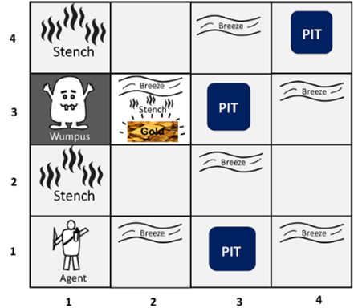
Following is a sample diagram for representing the Wumpus world. It is showing some rooms with Pits, one room with Wumpus and one agent at (1, 1) square location of the world.

Slide 40
There are also some components which can help the agent to navigate the cave. These components are given as follows:
A. The rooms adjacent to the Wumpus room are smelly, so that it would have some stench.
B. The room adjacent to PITs has a breeze, so if the agent reaches near to PIT, then he will perceive the breeze.
C. There will be glitter in the room if and only if the room has gold.
D. The Wumpus can be killed by the agent if the agent is facing to it, and Wumpus will emit a horrible scream which can be heard anywhere in the cave.

Slide 41
Sensors:
The agent will perceive the stench if he is in the room adjacent to the Wumpus. (Not diagonally).
The agent will perceive breeze if he is in the room directly adjacent to the Pit.
The agent will perceive the glitter in the room where the gold is present.
The agent will perceive the bump if he walks into a wall.
When the Wumpus is shot, it emits a horrible scream which can be perceived anywhere in the cave.
These percepts can be represented as five element list, in which we will have different indicators for each sensor.
Example if agent perceives stench, breeze, but no glitter, no bump, and no scream then it can be represented as:
[Stench, Breeze, None, None, None].

Slide 42
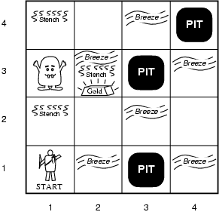
Practical Example (The Wompus world)
Goal: Agent wants to move to the square which holds Gold, grab it and come back to the original square and release it there
Initially agent could be at any of the square
Environment
Squares adjacent to wumpus are smelly(stench)
Squares adjacent to pit are breezy
Glitter iff gold is in the same square
Shooting kills wumpus if agent is facing to it
Shooting uses up the only arrow
Grabbing picks up gold if in same square
Releasing drops the gold in same square

Slide 43
Practical Example (The Wompus world)
Performance measure
Grab gold has score of 1000,
death by pits or wompus score -1000
using the arrow (shooting) score -10 and
the rest ation score -1
Sensors: Stench, Breeze, Glitter, Bump, Scream
Actuators: turn left 90º, turn right 90º, Forward, Grab, Release, Shoot

Slide 44
Practical Example (The Wompus world)
Characterization
Fully Observable No – only local perception
Deterministic Yes – outcomes exactly specified
Episodic No – sequential at the level of actions
Static Yes – Wumpus and Pits do not move
Discrete Yes
Single-agent? Yes – Wumpus is essentially a natural feature

Slide 45
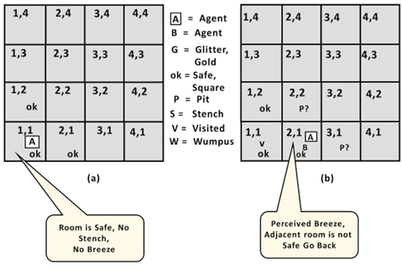
Exploring the Wumpus world:
Now we will explore the Wumpus world and will determine how the agent will find its goal by applying logical reasoning.
Agent's First step:
Initially, the agent is in the first room or on the square [1,1], and we already know that this room is safe for the agent, so to represent on the below diagram (a) that room is safe we will add symbol OK.
Symbol A is used to represent agent, symbol B for the breeze, symbol G for Glitter or gold, symbol V for the visited room, P for pits, W for Wumpus.
At Room [1,1] agent does not feel any breeze or any Stench which means the adjacent squares are also OK.

Slide 46
Agent's second Step:
Now agent needs to move forward, so it will either move to [1, 2], or [2,1].
Let's suppose agent moves to the room [2, 1], at this room agent perceives some breeze which means Pit is around this room. The pit can be in [3, 1], or [2,2], so we will add symbol P? to say that, is this Pit room?
Now agent will stop and think and will not make any harmful move. The agent will go back to the [1, 1] room. The room [1,1], and [2,1] are visited by the agent, so we will use symbol V to represent the visited squares.

Slide 47
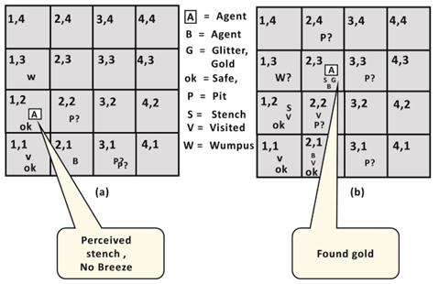
Agent's third step:
At the third step, now agent will move to the room [1,2] which is OK. In the room [1,2] agent perceives a stench which means there must be a Wumpus nearby.
But Wumpus cannot be in the room [1,1] as by rules of the game, and also not in [2,2] (Agent had not detected any stench when he was at [2,1]).
Therefore agent infers that Wumpus is in the room [1,3], and in current state, there is no breeze which means in [2,2] there is no Pit and no Wumpus. So it is safe, and we will mark it OK, and the agent moves further in [2,2].
Agent's fourth step:
At room [2,2], here no stench and no breezes present so let's suppose agent decides to move to [2,3]. At room [2,3] agent perceives glitter, so it should grab the gold and climb out of the cave.

Slide 48
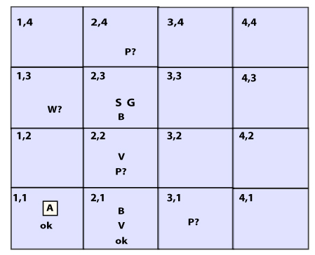
Knowledge-base for Wumpus world
The agent starts visiting from first square [1, 1], and we already know that this room is safe for the agent. To build a knowledge base for wumpus world, we will use some rules and atomic propositions.
We need symbol [i, j] for each location in the wumpus world, where i is for the location of rows, and j for column location.

Slide 49
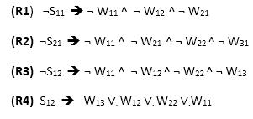
Atomic proposition variable for Wumpus world:
Let Pi,j be true if there is a Pit in the room [i, j].
Let Bi,j be true if agent perceives breeze in [i, j], (dead or alive).
Let Wi,j be true if there is wumpus in the square[i, j].
Let Si,j be true if agent perceives stench in the square [i, j].
Let Vi,j be true if that square[i, j] is visited.
Let Gi,j be true if there is gold (and glitter) in the square [i, j].
Let OKi,j be true if the room is safe.
Some Propositional Rules for the wumpus world:

Slide 50

Following is the Simple KB for wumpus world when an agent moves from room [1, 1], to room [2,1]:
Here in the first row, we have mentioned propositional variables for room[1,1], which is showing that room does not have wumpus(¬ W11), no stench (¬S11), no Pit(¬P11), no breeze(¬B11), no gold (¬G11), visited (V11), and the room is Safe(OK11).
In the second row, we have mentioned propositional variables for room [1,2], which is showing that there is no wumpus, stench and breeze are unknown as an agent has not visited room [1,2], no Pit, not visited yet, and the room is safe.
In the third row we have mentioned propositional variable for room[2,1], which is showing that there is no wumpus(¬ W21), no stench (¬S21), no Pit (¬P21), Perceives breeze(B21), no glitter(¬G21), visited (V21), and room is safe (OK21).

Slide 51
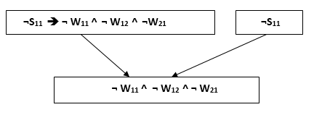
Prove that Wumpus is in the room (1,3) ?
We can prove that wumpus is in the room (1, 3) using propositional rules which we have derived for the wumpus world and using inference rule.
Apply Modus Ponens with ¬S11 and R1:
We will firstly apply MP rule with R1 which is ¬S₁₁ → ¬ W₁₁ ^ ¬ W₁₂ ^ ¬ W₂₁, and ¬S₁₁ which will give the output ¬ W₁₁ ^ W₁₂ ^ W₁₂.

Slide 52
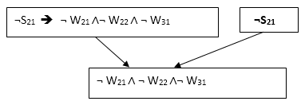
Prove that Wumpus is in the room (1,3) cont’d
Apply And-Elimination Rule:
After applying And-elimination rule to ¬ W₁₁ ∧ ¬ W₁₂ ∧ ¬ W₂₁, we will get three statements:
¬ W₁₁, ¬ W₁₂, and ¬W₂₁.
Apply Modus Ponens to ¬S₂₁, and R2:
By applying Modus Ponens to ¬S₂₁ and R2 which is ¬S₂₁ → ¬ W₂₁ ∧¬ W₂₂ ∧ ¬ W₃₁, which will give the Output as ¬ W₂₁ ∧ ¬ W₂₂ ∧¬ W₃₁

Slide 53
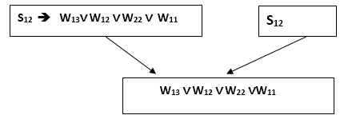
Prove that Wumpus is in the room (1,3) cont’d
Apply And -Elimination rule:
Now again apply And-elimination rule to ¬ W₂₁ ∧ ¬ W₂₂ ∧¬ W₃₁, We will get three statements:
¬ W₂₁, ¬ W₂₂, and ¬ W₃₁.
Apply MP to S₁₂ and R4:
Apply Modus Ponens to S₁₂ and R₄ which is S₁₂ → W₁₃ ∨. W₁₂ ∨. W₂₂ ∨.W₁₁, we will get the output as W₁₃∨ W₁₂ ∨ W₂₂ ∨.W₁₁.

Slide 54
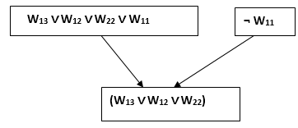
Prove that Wumpus is in the room (1,3) cont’d
Apply Unit resolution on W₁₃ ∨ W₁₂ ∨ W₂₂ ∨W₁₁ and ¬ W₁₁ :
After applying Unit resolution formula on W₁₃ ∨ W₁₂ ∨ W₂₂ ∨W₁₁ and ¬ W₁₁ we will get W₁₃ ∨ W₁₂ ∨ W₂₂.

Slide 55
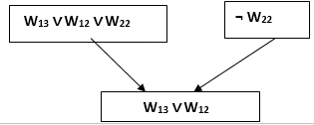
Prove that Wumpus is in the room (1,3) cont’d
Apply Unit resolution on W₁₃ ∨ W₁₂ ∨ W₂₂ and ¬ W₂₂ :
After applying Unit resolution on W₁₃ ∨ W₁₂ ∨ W₂₂, and ¬W₂₂, we will get W₁₃ ∨ W₁₂ as output.
Apply Unit Resolution on W₁₃ ∨ W₁₂ and ¬ W₁₂ :
After Applying Unit resolution on W₁₃ ∨ W₁₂ and ¬ W₁₂, we will get W₁₃ as an output, hence it is proved that the Wumpus is in the room [1, 3].

Slide 56
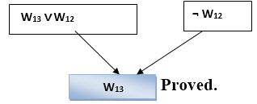
Prove that Wumpus is in the room (1,3) cont’d

Slide 57
The Wumpus World cont’d
Note that in each case for which the agent draws a conclusion from the available information, that conclusion is guaranteed to be correct if the available information is correct. This is a fundamental property of logical reasoning.

Slide 58
First order logic (FOL)
Lecture Outline
Limitations of Proposition Logic
Power of predicate logic
FOL function and predicate symbol
Syntax and semantics of FOPC
FOL sentence
Quantifier in FOL
Property of Quantifier
Free and bounded variable

Slide 59
First Order Logic
Properties of Propositional Logic
Propositional logic is declarative Propositional logic allows partial/disjunctive/negated information
(unlike most data structures and databases)
Propositional logic is compositional:
meaning of B_{1,1} ∧ P_{1,2} is derived from meaning of B_{1,1} and of P_{1,2}
Meaning in propositional logic is context-independent
(unlike natural language, where meaning depends on context)
Propositional logic has very limited expressive power

Slide 60
First Order Logic
Propositional logic is a weak language(limitations)
Propositional logic quickly becomes impractical, even for very small worlds
Hard to identify “individuals” (e.g., Mary, 3)
Can’t directly talk about properties of individuals or relations between individuals (e.g., “Bill is tall”)
Generalizations, patterns, regularities can’t easily be represented (e.g., “all triangles have 3 sides”)
First-Order Logic (abbreviated FOL or FOPC) is expressive enough to concisely represent this kind of information
FOL adds relations, variables, and quantifiers,

Slide 61
Propositional Logic Limitations
Some of the limitations of prepositional logic includes
Very limited expressive power: unlike natural language, propositional logic has very limited expressive power
Example cannot say “pits cause breezes in adjacent squares” except by writing one sentence for each square
It only represent declarative sentences: Propositional logic is declarative (sentence always have truth value)
Deals with only finite sentences: propositional logic deals satisfactorily with finite sentences composed using not, and, or, if . . . Then, iff
e.g., if there are 3 students A, B and C
taking p = “A has red hat”,
q = “B has red hat” and
r = “C has red hat”,
the formula “there exists a student with a red hat” may be modeled as p∨ q ∨ r.

Slide 62
Limitations….
On infinite models this may require infinite formulas;
Example:- “each natural number is even or odd” has to be translated as (p₀ ∨ q₀)∧(p₁ ∨ q₁) ∧(p₂ ∨ q₂) ∧ …
where p₀ ,p₁,p₂,… are even and q0,q1,q2,… are odd. .
The prepositional logic assumes the world consists of facts.
Cannot express the following:
All men are mortal
Socrates is a man
Therefore, Socrates is mortal
Propositional Logic has thus limited expressive power.

Slide 63
First Order Logic
Objects, Relations, Functions
Whereas propositional logic assumes world contains facts, first order logic (like natural language) assumes the world contains: Objects, Relations, Functions.
Objects: people, houses, numbers, theories, colors, football games, wars, centuries …
Relations: red, round, multistoried, brother of, bigger than, inside, part of, has color, occurred after, owns, comes between, …
Functions: father of, best friend, second half of, one more than, beginning of …

Slide 64
Combining the best of formal and natural languages
Indeed, almost any assertion can be thought of as referring to objects and properties or relations. Some examples follow:
“One plus two equals three.”
Objects: one, two, three, one plus two; Relation: equals; Function: plus. (“One plus two” is a name for the object that is obtained by applying the function “plus” to the objects “one” and “two.” “Three” is another name for this object.)
“Squares neighboring the wumpus are smelly.”
Objects: wumpus, squares; Property: smelly; Relation: neighboring.
“Evil King John ruled England in 1200.”
Objects: John, England, 1200; Relation: ruled; Properties: evil, king.

Slide 65
e.g.,“Every elephant is gray”: ∀ x (elephant(x) → gray(x))
“There is a white alligator”: ∃ x (alligator(X) ^ white(X))
Consider the problem of representing the following information:
Every person is mortal.
Confucius is a person.
Confucius is mortal.
How can these sentences be represented so that we can infer the third sentence from the first two?

Slide 66
Example….
In PL we have to create propositional symbols to stand for all or part of each sentence. For example, we might have: P = “person”; Q = “mortal”; R = “Confucius”
So the above 3 sentences are represented as: P → Q; R → P; R → Q
Although the third sentence is entailed by the first two, we needed an explicit symbol, R, to represent an individual, Confucius, who is a member of the classes “person” and “mortal”
To represent other individuals we must introduce separate symbols for each one, with some way to represent the fact that all individuals who are “people” are also “mortal”

Slide 67
Predicate Logic power
Equivalent names
Predicate logic
First Order Logic (FOL)
First Order Predicate Calculus (FOPC).
Predicate logic is an extension of propositional logic using variables for objects
It is much richer and complex than propositional logic.
Predicate logic has complex expressive power
e.g., If x represents a natural number, then “each natural number is even or odd” ”;may be written shortly as
∀x(E(x) ∨ O(x))
where E(x) = “x is even” and O(x) = “x is odd”

Slide 68
FOL function and predicate symbols
Function symbols are symbols that takes argument as a set of terms (variables, constant, functions) that represents a new object
Father(John)
Sucessor(X)
Sucessor(Sucessor(2))
A predicate symbols is a symbol which describes a relation between objects or property of an object
Father(solomon, gizaw)
Male(teshome)

Slide 69
Example1
Represent the statement “Not all birds can fly”
Let B(x) denotes “x is a bird.”
Let F(x): denotes “x can fly”;
~(∀x (B(x) → F(x)))
Does this equivalent to
∃x (B(x) ∧ ¬F(x))
some birds couldn’t fly
Represent the statement “All men are mortal. Socrates is man. Therefore, Socrates is Mortal”
Let: H(x) denotes “x is man”;
M(x) denotes “x is mortal ”, and s denotes Socrates;
The statement (2) may be described as:
∀ x(H(x) → M(x)), H(s) |- M(s)

Slide 70
Syntax & Semantics of FOPC
Sentence : Atomic Sentence ⏐ Sentence Connective Sentence ⏐ Quantifier Variable,… Sentence⏐ ~ Sentence ⏐ (Sentence)
AtomicSentence : Predicate(Term₁, Term2,…,Term_{n})⏐Term = Term
Term: Function(Term,…) ⏐ Constant ⏐ Variable
Connective : ∧ ⏐ ∨ ⏐ ⇔ ⏐ →
Quantifier : ∀ ⏐ ∃
Constant : A ⏐X₁⏐ KingJohn ⏐ ...
Variable : a ⏐ x ⏐ s ⏐ …
Predicate : Before ⏐HasColor ⏐ Raining ⏐…
Function : Mother ⏐LeftLegOf ⏐...

Slide 71
Term
A Term is a logical expression that refers to an object .
It is a name for a thing.
There are three kinds of terms which allows us to name things in the world.
Constant symbol, Example: John, Japan, Bacterium
Variable symbol, Example: x,y a, t,…
Function symbols, Example: f(f(x)); mother_of(John); LeftLegOf(John)
Note: A term with no variables is called a ground term.
For example
John, father(solomon)

Slide 72
Equality (=)
Two terms term₁ and term₂ are equal under a given interpretation if and only if term₁ and term₂ refer to the same object.
Example1:
If the object referred by Father(Kaleb) and the object referred to by Ayele are the same, then Father(Kaleb ) = Ayele

Slide 73
Predicate symbols
Predicate symbols: are symbols that stands to show a relationship among terms or to indicate property of a term.
For example:
On(A,B) to mean A is on B (relation between A & B)
Sister(Senait, Biruk) to mean Senaitis sister of Biruk
Female(Azeb) to mean Azeb is female (proprty of azeb being female)
Here ‘On’, ‘Sister’ and Female are predicate symbols, ‘A’, ‘B’, ‘Senait’, ‘Biruk’ and Azeb are terms.

Slide 74
Atomic sentences
Atomic sentences states the facts of world and is formed from a predicate symbol followed by a parenthesis list of terms.
Example:
Brother(Ali, Kedir)
Atomic sentences can have arguments that are complex terms:
Sister(mother_of(John),Jane)
Married(FatherOf(Richard),MotherOf(John))
An atomic sentence is true if the relation referred to by the predicate symbol holds between the objects referred to by the arguments.

Slide 75
Complex Sentence
Complex sentences are sentences which is a combination of one or more atomic sentences with logical connectives
Example:
Older(John,30) ∨ Younger(John,30); represents John is above 30
Brother(Robin,John)
represents Robin is Brother of John
Hana = daughter(brother(mother(Selam))) ;
represents Hana is Selam’s cousin
Father(Solomon, Tesfaye)→father(Solomon, Biruk)
Represents if solomon is father of Tesfaye then he is also father of Biruk

Slide 76
Quantifiers
A quantifier is a symbol that permits one to declare, or identify the range or scope of the variables in a logical expression.
A quantifier express properties of entire collection of objects.
There are two types of quantifier
Universal quantifier ∀
Existential quantifier ∃

Slide 77
Universal Quantification (∀)
Universal quantifier defines the domain of a variable in a logical expression to be any element in the universe.
If x is a variable, then, ∀ x is read as
for all x OR for each x OR for every x
The scope of universal quantifier is the whole element in the domain
Syntax: ∀<variables> <sentence>
one or more variables can be quantified by a single quantifier by separating with comma. Eg. ∀x,y
Example1: “Every student is smart:”
∀x (Student(x) → Smart(x))
Example2: “All cats are mammals”
∀ x (cats(x)→ Mammals(x))

Slide 78
Universal Quantification (∀)
Roughly speaking, ∀ is equivalent to the conjunction of an instantiations of P
∀x (Student(x) → Smart(x)) is equivalent to
(Student(KingJohn) → Smart(KingJohn)) ∧
(Student(Abera) → Smart(Abera)) ∧
(Student(MyDog) → Smart(MyDog)) ∧...
∀x(cats(x)→ Mammals(x)) is equivalent to
(Cat(Spot) → Mammals(Spot)) ∧
(Cat(Rebecca) → Mammals (Rebecca)) ∧
(Cat(Felix) → Mammals (Felix)) ∧
(Cat(John) → Mammals (John)) ∧ …

Slide 79
Universal Quantification (∀)
Note1: Typically, → is the main connective with ∀
Note2: Avoid the mistake of using ∧ as the main connective with ∀:
Example:
∀x (Student(x) ∧ Smart(x)) means “Everyone is a student and everyone is smart”
∀x(cats(x) ∧ Mammals(x)) means “Everything is a cat and every thing is mammal”
This doesn’t agree in concept with the original sentence which is every student is smart, every cat are mammal respectively.

Slide 80
Existential quantification (∃)
Existential quantifier defines the domain of a variable in a logical expression to be a non empty set which is the subset of the universal set.
if y is a variable, then ∃ y is read as
There exists a y OR for some y OR for at least one y
Syntax: ∃<variables> <sentence>
one or more variables can be quantified by a single quantifier by separating with comma. Eg. ∃x,y
Example1: “Some students are smart”
∃x (student(x) ∧ Smart(x))
Example2: “Spot has a sister who is a cat”
∃x(Sister(x, Spot) ∧ Cat(x))

Slide 81
Existential quantification (∃)
Roughly speaking, ∃ is equivalent to the disjunction of instantiations of P
∃x(student(x) ∧ Smart(x)) is equivalent to
(Student(KingJohn) ∧ Smart(KingJohn)) ∨
(Student(Abera) ∧ Smart(Abera)) ∨
(Student(MyDog) ∧ Smart(MyDog)) ∨...
∃x(Sister(x, Spot) ∧ Cat(x)) is equivalent to
(Sister(Felix, Spot) ∧ Cat(x)) ∨
(Sister(Rabicca, Spot) ∧ Cat(x)) ∨
(Sister(chichu, Spot) ∧ Cat(x)) ∨…

Slide 82
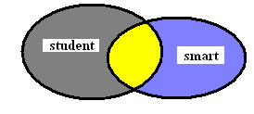
Existential quantification (∃)
Note1: Typically, ∧ is the main connective with ∃.
Note2: Avoid the mistake of using → as the main connective with ∃:
Example:
Some students are smart is to mean that there are entities that satisfy the property of both being a student and smart.
In the figure, the yellow part indicates the set of such groups
However, ∃x(student(x) → Smart(x)) is to means any thing which is either smart or not a student
Hence this doesn’t infer what we need to say

Slide 83
Examples using Quantifiers
Man(John)
John is a man
∀x(Man(x) → ~Woman(x))
Every man is not a woman (there is no man who is a woman)
∃x(Man(x) ∧ Handsome(x))
Some man are handsome
∀x(Man(x) → ∃y(Woman(y) ∧ Loves(x,y)))
Every man has a woman that he loves
∃y(Woman(y) ∧ (∀x)(Man(x) → Loves(x,y)))
There are some woman that are loved by every man

Slide 84
Nested quantifiers
Universal and existential quantifiers can be nested one into another.
It is possible to have one or more quantifier nested in another quantifier
Example1
“For all x and all y, if x is the parent of y then y is the child of x” can be represented as
∀x,y (Parent(x,y)→Child(y,x))
Note: Here ∀x,y means ∀x ∀y
Example2
“There is someone who is loved by everyone
∃y∀x Loves(x,y)

Slide 85
Nested quantifiers
Difficulty may arise when two quantifiers are used with the same variable name.
For example
∀x (Cat(x) ∨ ∃x Brother(Richard,x)))
In the sentence above, x in Brother(Richard,x) is existentially qualified and the universal quantifier has no effect on it.
Rule: To identify which quantifier quantify a variable if the variable is quantified by two or more of them, the innermost quantifier that mentions it will be choosen.

Slide 86
Examples of Translating English to FOL
1. Every gardener likes the sun.
(∀x) (gardener(x)→likes (x,sun))
2. All purple mushrooms are poisonous
(∀x) [(mushrooms(x)∧ purple(x)) → poisonous(x)]
3. No purple mushroom is poisonous
~(∃x) (purple(x) ∧ mushroom(x) ∧ poisonous(x))
4. There are exactly two purple mushrooms
(∃x)(∃y) {mushroom (x) ∧ purple(x) ∧ mushroom(y) ∧ purple(y) ∧ ~(x=y) ∧ (∀z)[(mushroom(z) ∧ purple(z)) → ((x=z)∨(y=z))]}
5. You can fool some of the people all of the time
(∃x)(person(x) ∧ (∀ t) (time(t) →can-fool(x,t)))
6. Jane is a tall surveyor
Tall(Jane) ∧ Surveyor(Jane)

Slide 87
Examples of Translating English to FOL
7. Everybody loves somebody
∀x ∃y Loves(x,y)
∃y ∀x Loves(x,y)
8. Nobody loves Jane
∀x ~Loves(x,Jane)
~∃y Loves (y,Jane)
9. Everybody has a father
∀x ∃y Father(y,x)
10. Everybody has a father and mother
∀x ∃y,z (Father(y,x) ∧ Mother(z,x))
12. Whoever has a father has a mother
∀x ∃y (Father(y,x) → ∃z Mother(z,x))
13. Every son of my father is my brother
∀x∀y ((MyFather(x) ∧ Son(y,x)) → MYBrother(y))

Slide 88
Properties of quantifiers (commutativity)
∀x∀y is the same as ∀y ∀x
∃x∃y is the same as ∃y ∃x
∃x∀y is not the same as ∀y ∃x,
Example
∃x ∀y Loves(x,y) means “There is a person who loves everyone in the world”
∀y ∃x Loves(x,y) means “Everyone in the world is loved by at least one person”

Slide 89
Properties of quantifiers (duality)
Quantifier duality refers to the possibility of expressing one quantifier with the other equivalently
Universal quantifier can be completely replaced by existential quantifier without affected the meaning and vise versa
Example
∀x Likes(x,IceCream) ≡ ¬∃x ¬Likes(x,IceCream)
∀x Likes(x,IceCream) ≡ Everyone likes ice cream
¬∃x ¬Likes(x,IceCream) ≡ there is no one who does not like ice cream.
∃x Likes(x,Broccoli) ≡ ¬∀x ¬Likes(x,Broccoli)
∃x Likes(x,Broccoli) ≡ Some one likes Broccoli
¬∀x ¬Likes(x,Broccoli) ≡ It is not true that every one doesn’t like Broccoli

Slide 90
Properties of quantifiers (duality)
Quantifiers are intimately connected with each other, through negation.
Example: If one says that everyone dislikes bitter guard one is also saying that there does not exists someone who likes them or vice versa.
∀ is really conjunction over the universe of objects and
∃ is a disjunction over the universe, they obey De Morgan’s rules.
De Morgan rules for quantified & un-quantified sentences are as follows:
1. (∀x ¬P(x)) ≡ ¬(∃x P(x))
2. (∀x Q(x)) ≡ ¬(∃x ¬Q(x))
3. (∃x ¬P(x)) ≡ ¬(∀x P(x))
4. (∃x Q(x)) ≡ ¬(∀x) ¬Q(x))
In fact, one quantifier can do both works, if used with negation in appropriate place.

Slide 91
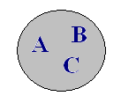
Properties of quantifiers (duality)
Consider a world consists of only three object A
Hence ∀x P(x) ≡ (P(A) ∧ P(B) ∧ P(C))
≡¬ ¬ (P(A) ∧ P(B) ∧ P(C))
≡¬ (¬ P(A) ∨ ¬ P(B) ∨ ¬ P(C))
≡¬ (∃x ¬ P(x) )
Syntax & Semantics of FOPC
∀x [~P(x)] | P is false for all x
∃x [~P(x)] | P is false for some x
∀x [P(x)] | P is true for all x
∃x [P(x)] | P is true for some x

Slide 92
Normal Forms:
A well formed formula can be represented in different standard normal forms
Some of the normal forms are
1. Clause Form: disjunction of literals (atomic sentences)
2. Conjunctive Normal Forms (CNF): conjunction of disjunction of literals or atomic sentences.
It can also be defined as conjunction of clauses
3. Disjunctive Normal Form (DNF): disjunction of conjunction of literals.

Slide 93
Normal Forms:
Conjunctive Normal Form (CNF) is the focus of the chapter since:
Any well formed formula (logical expression) can be converted into CNF
Generalized resolution is a complete inference procedure on CNF expression KB
It provides an easy way of inference procedure for the computer through resolution and refutation
A single literal (atomic sentence) or a single clause is in CNF form
Q ≡ Q ∨ False
~Q ≡ ~Q ∨ False

Slide 94
Conjunctive Normal Forms
Steps to convert form predicate logic formula to CNF.
Eliminate implications and bi-conditionals.
(A → B) = ~A ∨B
(a⇔B) = (A→B) ∧ (B → A)
Reduce the scope of negation and apply De Morgan’s
theorem to bring negations before the atoms
~(A∨B) = ~A ∧ ~B
~(A ∧ B) = ~A ∨ ~B
To bring the signs before the atoms, use the duality relation formulae
~∀x(A(x)) = ∃ x(~A(x))
~(∃ x (A(x)) = ∀ x( ~A(x))
For the sake of clarity (to avoid repetition) rename bound variables if necessary.
Use the equivalent formulae to move the quantifiers to the left of the formulae to obtain the normal form

Slide 95
Conversion exercise into its normal form
∀x (A(x)→ ∃y B(x,y)) ---(1)
≡ ∀x (~A(x) ∨ ∃y B(x,y)) implication elimination
≡ ∀x ∃ y(~A(x) ∨ B(x,y)) pushing ∃ to the front
- (solution)
∃x (A(x) → ∀x B(x))
≡ ∃x (A(x) → ∀y B(y)) variable renaming
≡ ∃x (~A(x) ∨ ∀y B(y)) eliminating →
≡ ∃x∀y (~A(x) ∨ B(y)) pushing ∀ to the front

Slide 96
Conversion exercise into its NF
3. ∃x A(x) → ∀x B(x)
≡ (∃x A(x)) → ∀y B(y) scoping and renaming
≡ ~(∃xA(x)) ∨ ∀y B(y) → elimination
≡ ∀x ~A(x) ∨ ∀yB(y) pushing ~ inward
≡ ∀x∀y (~A(x) ∨ B(y)) pushing ∀ to the front
≡ ∀x,y (~A(x) ∨ B(y)) using single∀ quantifier

Slide 97
Propositional logic
Assumes that the world contains facts
Problems with propositional logic
• No notion of objects
• No notion of relations among objects
In Propositional Logic, we define A1 as “American sits
at seat 1.” The meaning of A1 is instructive to us, suggesting
– there is an object we call American,
– there is an object we call “seat 1”,
– there is a relationship “sit” between these two objects
• Formally, none of these are in Propositional Logic.

Slide 98
First-Order Logic
It models the world in terms of
– Objects, which are things with individual identities
– Properties of objects that distinguish them from other objects
– Relations that hold among sets of objects
– Functions, which map individuals in the domain to another in the domain.
Examples:
Objects: Students, lectures, companies, cars ...
Properties: blue, oval, even, large, ...
Relations: Brother-of, bigger-than, outside, part-of, has-color,
occurs-after, owns, visits, precedes, ...
Functions: father-of, best-friend, second-half, one-more-than

Slide 99
Quiz
1. What is first order logic, why we need it and how it models the world ?
Translating English to FOL
John and Michael are colleagues
Some boys play cricket.
Brothers are siblings
Only one student failed in Mathematics.
Each student is registered for at least one degree programme
Conversion exercise into its normal form
∃x (A(x) → ∀x B(x))
∀Y (∀X (taller(Y,X) V wise(X)) => wise(Y))

Slide 100
Quiz
1. What is the limitation of prepositional logic, what is the solution and how the solution models the world ?
Translating English to FOL
Some people like Football.
Every man respects his parent.
Brothers are siblings.
Not all students like both Mathematics and Science.
Each student is registered for at least one degree programme.
Conversion exercise into its normal form
∀x (A(x)→ ∃y B(x,y))
∀Y (∀X (taller(Y,X) V wise(X)) => wise(Y))

Slide 101
John and Michael are colleagues
Colleagues (John, Michael)
2. Some boys play cricket.
∃x boys(x) → play(x, cricket).
3. Brothers are siblings.
∀x, y (Brother(x, y) ⇒ Sibling(x, y))
4. Only one student failed in Mathematics.
∃(x) [ student(x) → failed (x, Mathematics) ∧∀ (y) [¬(x==y) ∧ student(y) → ¬failed (x, Mathematics)].
5. Each student is registered for at least one degree programme’
∀x(Student(x)→∃y(registeredfor(x,y)∧DegreeProgramme(y)))

Slide 102
1. Some people like Football.
∃x: people(x) ∧ likes Football(x)
2. Every man respects his parent.
∀x man(x) → respects (x, parent).
3. Brothers are siblings.
∀x, y (Brother(x, y) ⇒ Sibling(x, y))
4. Not all students like both Mathematics and Science.
¬∀ (x) [ student(x) → like(x, Mathematics) ∧ like(x, Science)].
5. Each student is registered for at least one degree programme’
∀x(Student(x)→∃y(registeredfor(x,y)∧DegreeProgramme(y)))

Slide 103
THANKS!!

